Slide 1

Semantic and morphophonological productivity of Kîîtharaka noun classes: corpus and experimental evidence
Patrick Kanampiu¹, Alexander Martin², Jennifer Culbertson¹
LAEA 3 Conference
(August 15-16, 2023)
¹University of Edinburgh, UK
²University of Groningen, Netherlands

Slide 2
Noun class systems
Nouns grouped based on agreement (Hockett 1958, Corbett 1991, Katamba 2006)
Used interchangeably with gender (Corbett, 1991:1; Aikhenvald, 2006)
Kîîtharaka
(1) | mûthaka | ûûra
 | 1.young man | 1.dem.dist
(2) | kîbanga | kîîra
 | 7.machete | 7.dem.dist
(3) | ibanga | biira
 | 8.machete | 8.dem.dist
French
(4) | le | vieil | homme | homme
 | Det.M | old.M | man.M | man.M
(5) | la | camionnette
 | Det.F | van.F

Slide 3
What determines noun class in language?
Semantics (Corbett 1991, Contini Morava 1997, Aikhenvald 2019 etc)
Form of the noun (morphology and/or phonology) (e.g., Bleek 1869, Helden 1993, Biswanandan 2014, Corbett 1991, 2022, etc)
Kîîtharaka
(6) | mûthaka | ûûra
 | 1.young man | 1.dem.dist
(7) | kîbanga | kîîra
 | 7.machete | 7.dem.dist
(8) | ibanga | biira
 | 8.machete | 8.dem.dist
French
(9) | le | vieil | homme | homme
 | Det.M | old.M | man.M | man.M
(10) | la | camionnette
 | Det.F | van.F
semantics
(human)
semantics
(male)
morpho-
phonology
(kî-)
morpho-
phonology
(-ette)

Slide 4
What determines noun class in language?
But there are typically, many exceptions!
Kîîtharaka
(11) | mûthaka | ûûra
 | 1.young man | 1.dem.dist
(12) | kîroria | kîîra
 | 7.prophet | 7.dem.dist
(3) | ibanga | biira
 | 8.machete | 8.dem.dist
French
(13) | le | vieil | homme | homme
 | Det.M | old.M | man.M | man.M
(14) | la | personne
 | Det.F | person.F
semantics
(human)
semantics
(male)
?
?

Slide 5
What determines noun class in a language?
But there are typically, many exceptions!...
Kîîtharaka
(15) | kîbanga | kîra
 | 7.machete | 7.dem.dist
(16) | îthe | ûra
 | 5.father | 1.dist.dem
(17) | nkoma | ûyû
 | 9.devil | 1.dem.prox
French
(18) | la | camionnette
 | Det.F | van.F
(19) | le | squelette
 | Det.M | skeleton.M
morpho-
phonology
(kî-)
morpho-
phonology
(-ette)
?
?
?

Slide 6
Theoretical and empirical questions…
How do we know what semantic or morphophonological cues are productive amidst such exceptions?
Do speakers treat different types of cues the same way? (e.g., Karmiloff-Smith, 1981; Perez-Pereira 1991; Gxilishe et al., 2009; Gagliardi & Lidz 2014 a.o.)
Issues with traditional accounts of noun class in Bantu
  Assumption that class is indicated by the prefix alone
  Assumption that semantics is centrally important to class assignment (see e.g., wa Mberia, 1993 for similar observations)
  No formal theory of what makes a semantic or (morpho)phonological cue productive

Slide 7
A different approach to Kîîtharaka
The project aims to establish productive features that determine noun class membership in Kîîtharaka:
  Corpus analyses using Tolerance Principle (Yang, 2016)- provides a way of establishing productivity of rules in a set of items with exceptions (exceptions should not exceed a certain threshold)
  Psycholinguistic tests – shows what speakers pay attention to
  Includes testing the relative importance of semantic and morpho-phonological cues (following e.g., Karmiloff-Smith, 1981; Gagliardi & Lidz 2014, and others).

Slide 8
Building a Corpus
The study uses a corpus (2327 nouns)
  901 collected from Kîîtharaka bible (published in 2019) and,
  1426 translated from SIL comparative African Wordlist (Snider
and Roberts, 2006).
  Translation of SIL list done to achieve a balanced corpus
Coded for singular/plural agreement, semantics and morphophonological features (prefixes).

Slide 9
Semantic features coded for
Expected Class | Semantic Feature(s)
1 | human
3 | Extended shape, spread shape, protruding shape, trees & plants, dispersive mass
5 | Fruits, round shape, plant part, augmentative, made of wood, cohesive mass
7 | Artefacts, pejorative, derived
9 | Animals, artefacts, loan (other)
11 | Narrow things, wavy-shaped things
12 | Diminutives
14 | Abstract, mass
15 | Derived, infinitives

Slide 10
Morphophonological features coded for
Morphophonological feature | Expected class
Mû- | 1
Mû- | 3
Î- | 5
Kî- | 7
N, ø | 9
Rû- | 11
Ka- | 12
Û- | 14
Kû- | 15

Slide 11
Corpus Analysis
Corpus analysed for rule productivity using Tolerance Principle (Yang, 2016)
Tolerance Principle demonstrates how to establish the productivity of rules with exceptions.
  Proposed to account for how and when e.g., language learners make generalizations and when they don’t.
  provides a threshold beyond which the exceptions should not exceed for the rule to be productive.
  Makes use of 2 integer values N (number of items in the lexicon) and e (number of items not obeying the rule)
  Let a rule be defined over a set of N items.
  The rule is productive if the number of exceptions does not exceed a threshold, 𝛉_{N.}
  exceptions (e) ≤ 𝛉_{N} (N/ln(N))

Slide 12

Corpus Results

Slide 13
Results: a productive semantic feature for class 5
Rule: [+augmentative ] class 5
Semantic features | N | Class 5 | e | 𝛉_{N} | Productive?
Human | 252 | 2 | 250 | 46 | No?
Augmentative | 32 | 25 | 7 | 9 | Yes
Round | 44 | 12 | 32 | 12 | No
Plant part | 47 | 6 | 41 | 12 | No
Fruit | 17 | 8 | 9 | 6 | No
Made from wood | 12 | 1 | 11 | 5 | No
Derived | 1081 | 40 | 1041 | 155 | No
Cohesive mass | 58 | 5 | 53 | 14 | No

Slide 14
Results: a productive semantic rule (recursive appl.)
Rule: [+human, -pejorative] Class 1
Semantic features | N | Class 1 | e | 𝛉_{N} | Productive?
Human | 252 | 197 | 52 | 46 | No
[+human, -Pejorative] | 235 | 197 | 38 | 43 | Yes

Slide 15
Corpus results: productive semantic features (overall)
[+Human] class 1
[+augmentative] class 5
[+pejorative] class 7
[+diminutive] class 12
[+derived] class 15
[+infinitive] class 15

Slide 16
Results: a productive morphophonological feature
Rule: [+kî-] class 7
Morpho-phonological features | N | Class 7 | e | 𝛉_{N} | Productive?
mû- | 397 | 0 | 397 | 66 | No?
rû- | 122 | 0 | 122 | 25 | No
kî- | 268 | 262 | 6 | 48 | Yes
ri- | 5 | 0 | 5 | 3 | No
kû- | 677 | 0 | 677 | 104 | No
û- | 107 | 0 | 107 | 23 | No
î- | 188 | 0 | 188 | 36 | No
ka | 82 | 0 | 82 | 19 | No
n- | 329 | 0 | 329 | 57 | No

Slide 17
Results: a productive morphophonological rule
Rule: +mû- [+human] Class 1
Hybrid features | N | Class 1 | e | 𝛉_{N} | Productive?
mû- | 397 | 162 | 235 | 66 | No
[+mû-, +human] | 166 | 162 | 4 | 32 | Yes
Rule: +[+mû-, -human] Class 3
Hybrid features | N | Class 3 | e | 𝛉_{N} | Productive?
mû- | 235 | 235 | 162 | 66 | No
[+mû-, -human] | 235 | 235 | 0 | 43 | Yes

Slide 18
Results: productive morphophonological features
[+î-/rî-] class 5
[+kî-] class 7
[+n-] class 9
[ø-] class 9
[+rû-] class 11
[+ka-] class 12
[+û-] class 14
[+kû-] class 15
[[+mû], + human]] class 1
[[+mû, -human]] class 3

Slide 19
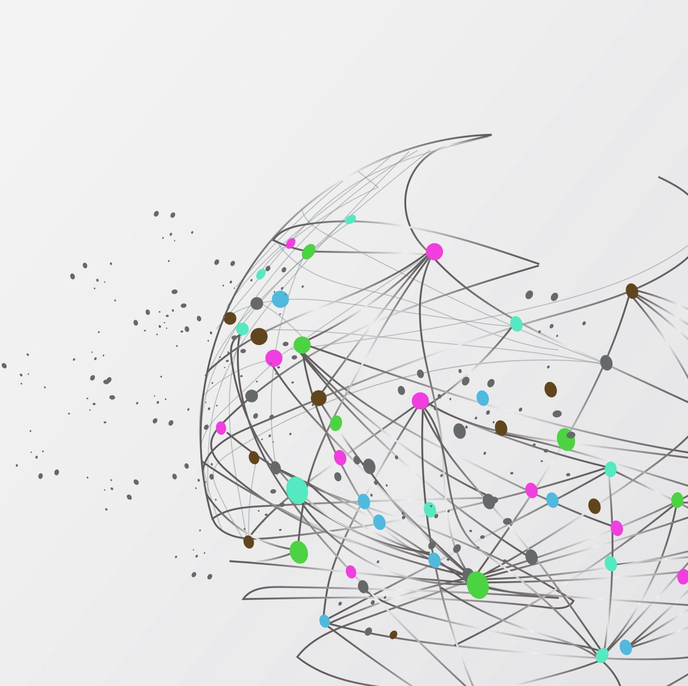
Experiments: Observation of human behaviour
Test to what extent statistical measure of productivity reflects speakers’ own usage
  3 experiments (2 done)
  30 native speakers (males & females; age 18—45)

Slide 20
Experiment 1: Semantic features tested
Semantic Feature | Expected Class
Human | 1
Extended | 3
Augmentative | 5
Fruits | 5
Artefacts | 7
Pejorative | 7
loan (other) | 9
Narrow | 11
Wavy | 11
Diminutive | 12

Slide 21
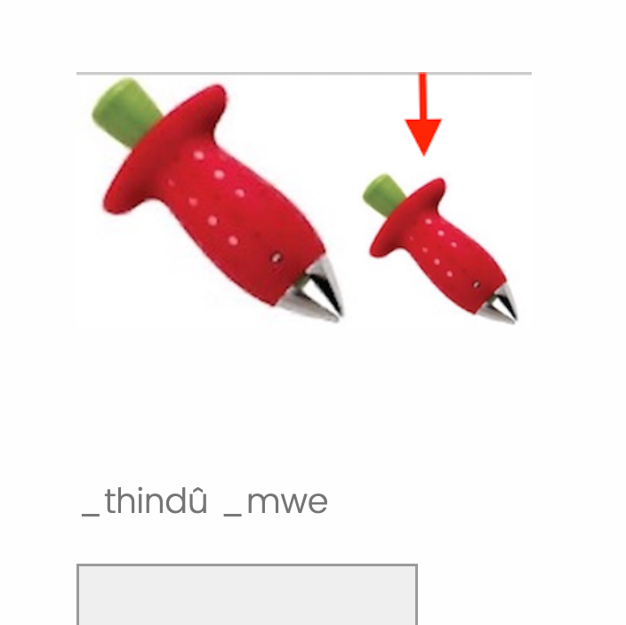
Stimuli
Participants saw an unfamiliar image followed by a DP(novel noun> num) with an underscore at the beginning of each word
Required to use their Kîîtharaka knowledge to judge if part of the words were missing and type them in full.
Order in which the stimuli appeared and image-DP pairing randomized across participants
  Each feature tested 3 times, 30 images, 30 novel nouns

Slide 22
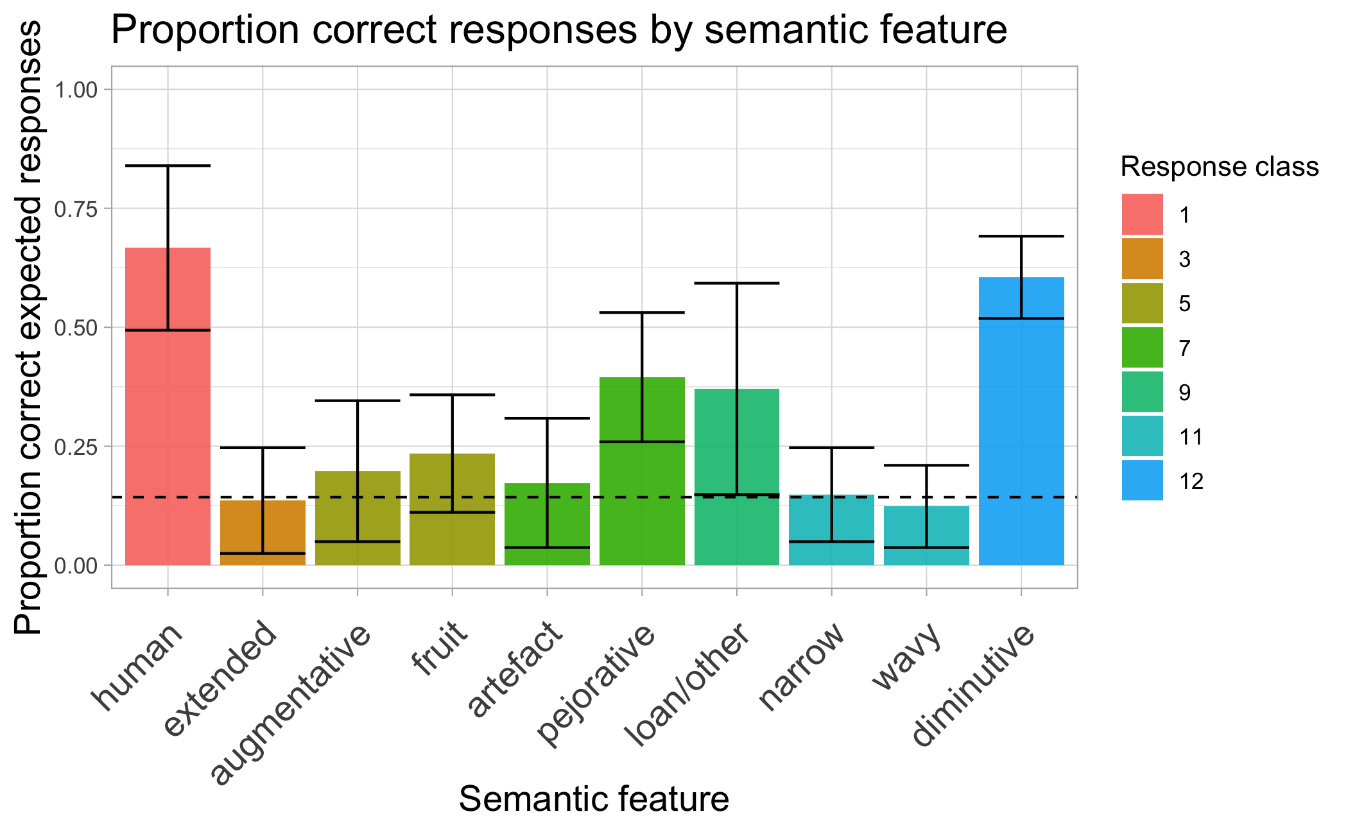
Experiment 1 results: productive semantic features

Slide 23
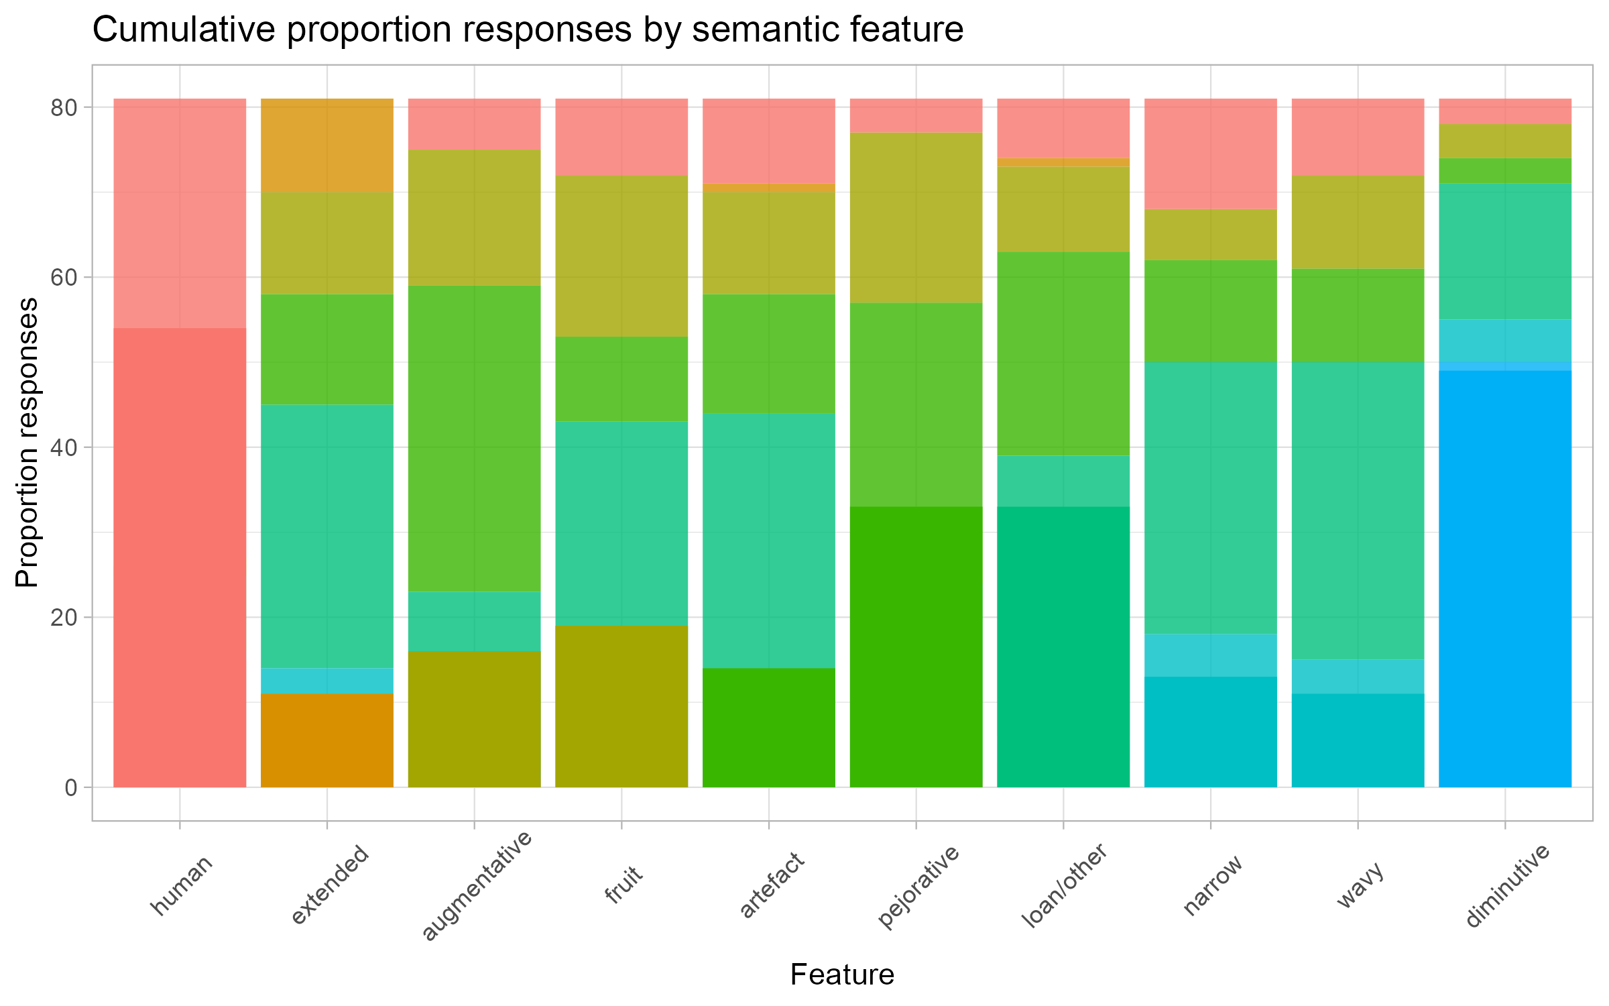
Experiment 1 results: productive semantic features

Slide 24
Experiment 2: Morphophonological features tested
Morphophonological feature | Expected class
Mû- | 1
Mû- | 3
Î- | 5
Kî- | 7
N, ø | 9
Rû- | 11
Ka- | 12
Û- | 14
Kû- | 15

Slide 25
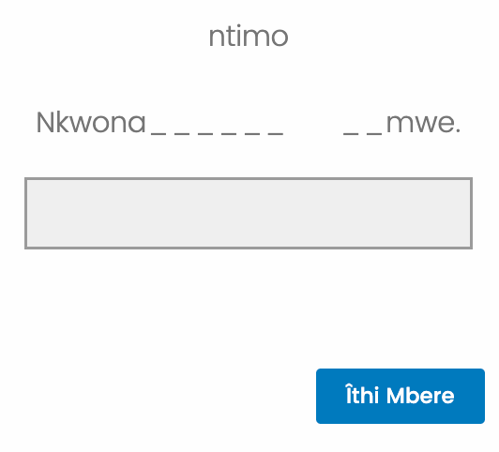
Stimuli
Morphophonological experiment
Morphophonological experiment
  Participants saw a (non)prefixed novel noun followed by a short sentence with two gaps, as in Nkwona ____ _mwe “I have seen _one ____”.
    Required to fill in the gaps using the noun seen and its agreement

Slide 26
Experiment 2: Morphophonological features tested
  Prefix-agreement pairing tested in three levels:
    Singular prefix – singular agreement
    Plural prefix – Plural agreement
    Singular prefix – Plural noun + agreement
  Participants (30 native speakers, age 18-45)

Slide 27
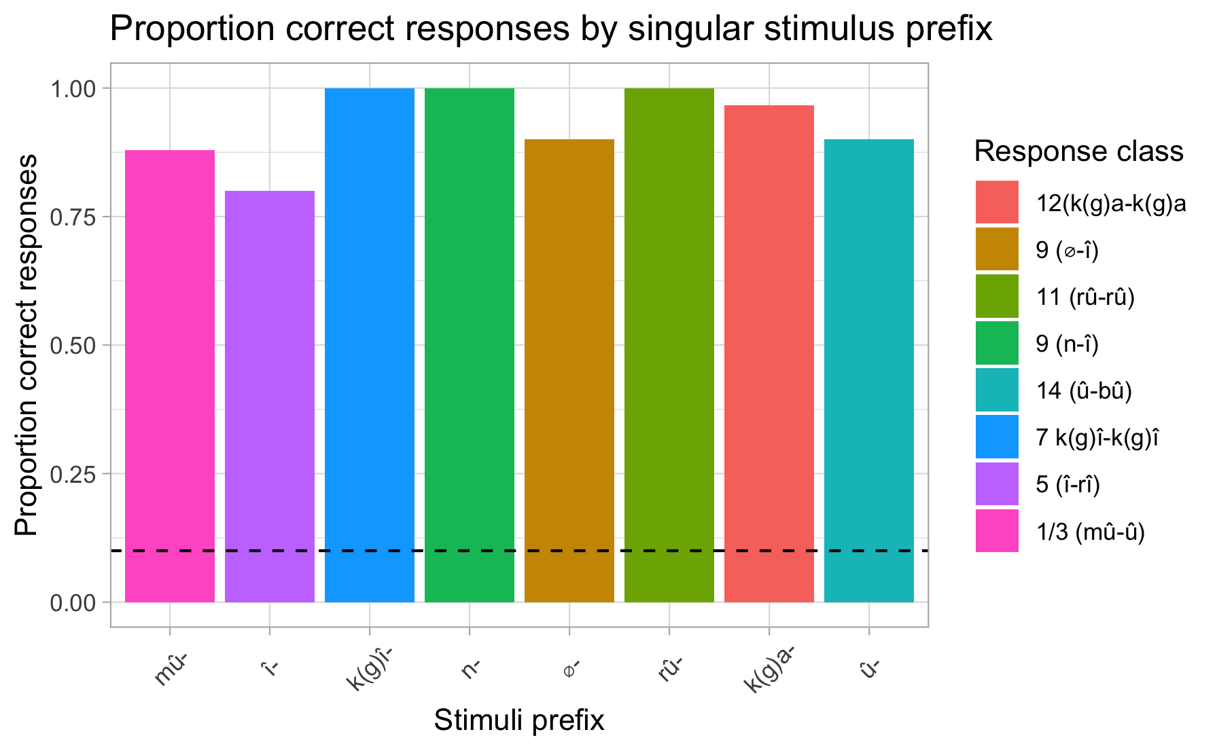
Results: productive morphophonological features
singular stimulus – singular agreement (class)
Both singular and plural prefixes highly productive as cues to agreement
Singular prefixes – plural prefixes/classes have reduced productivity

Slide 28
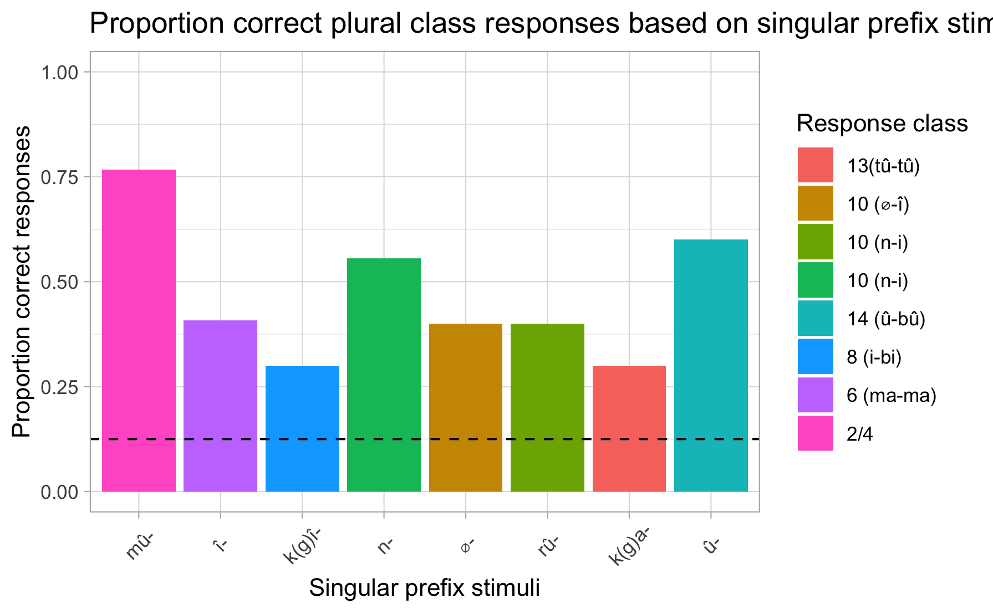
Results: productive morphophonological features
singular stimulus – plural agreement (class)
Both singular and plural prefixes highly productive as cues to agreement
Singular prefixes – plural prefixes/classes have reduced productivity

Slide 29
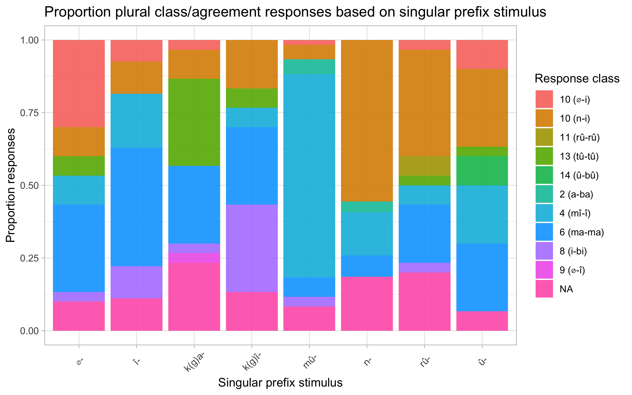
Results: productive morphophonological features
singular stimulus – plural agreement (class)
NA:
Impossible prefix –agr pairing (few)
or incomplete:
Ntagi îthatû
Nciira

Slide 30
Does Experiment 1 confirm TP predictions?
    The experimental results largely mirrors the the TP predictions:
      ¾ features predicted by TP are productive.
      Augmentative unproductive in the experiment
    Productivity of ‘other’ at chance in the experiment (was unproductive in the corpus)

Slide 31
Does Experiment 2 confirm TP predictions?
All prefixes productive in the corpus also productive in the experiment
The mû- prefix is interesting–only productive for class 3
  Prefix is underspecified– but why is it overwhelmingly productive for class 3?
    Could be a default morphophonological rule that applies in the absence of semantic specification
    Could be because non-human are more represented in the world than humans

Slide 32
Implications
A theory of productivity is instrumental in establishing which features productively determine nominal (gender) agreement
  Experimental results reflect TP based results to a greater extent.
Both semantics and formal features are necessary cues to class in Kîîtharaka
  Semantics- human–nonhuman distinction (class 1/2 vs others); evaluation (class 5, 7, 12)
  Morphophonology- applies productively for all non-human non-evaluative classes
Singular-plural class mapping somewhat regular in 1/3, 9 and 14 and less of it in other classes (level 3 exp. 2) – interesting?

Slide 33
The End
I bwega!
Thank you!

Slide 34
References
Aikhenvald, A. (2003). Classifiers: A typology of noun categorization devices. Oxford: Oxford University Press.
Amidu, A.A. 1997. Classes in Kiswahili. Köln: Rüdiger Köppe Verlag.
Bible Translation & Literacy (EA). (2019). Bibiria: Kîrîîkanîro kîra gîkûrû na kîrîîkanîro kîra kîyerû. Nairobi: Bible Translation & Literacy (EA).
Bleek, W.H.I. (1862-1969). A Comparative Grammar of South African Languages, I: Phonology (1862), II: The Concord, section I: The Noun (1869). London: Trubner. (Republished 1971 in one volume, Farnborough: Gregg.)
Brooks, P. J., Braine, M. D., Catalano, L., Brody, R. E., & Sudhalter, V. (1993). Acquisition of gender-like noun subclasses in an artificial language: The contribution of phonological markers to learning. Journal of Memory and Language, 32, 76–95.
Carstens, V., (1991). The morphology and syntax of determiner phrases in Kiswahili. UCLA PhD thesis.
Corbett, G.G. 1991. Gender. Cambridge Mass.: Cambridge University Press.
Demuth, K. (1992). Acquisition of Sesotho. In Slobin, D. (Ed.), The cross-linguistic study of language acquisition (Vol. 3, pp. 557–638). Hillsdale, NJ: Lawrence Erlbaum.
Demuth, K. (1994). On the ‘underspecification’ of functional categories in early grammars. In Lust, B., Suñer, M., Whitman, J. (Eds.), Syntactic theory and first language acquisition: Cross-linguistic perspectives (pp. 119–134). Hillsdale, NJ: Lawrence Erlbaum.
Demuth, K. (2000). Bantu noun class system: Loan words and acquisition. (G. Senft, Ed.) Classification Systems, 270-292.
Demuth, K., & Ellis, D. (2008). Revisiting the acquisition of Sesotho noun class prefixes. Mahwah, NJ: Lawrence Erlbaum.
Denny, J.P. & Creider, C.A. 1986. The semantics of noun classes in Proto-Bantu. In Noun classes and categorization. C. Craig, Ed. Amsterdam/ Philadelphia: John Benjamins Publishing Company.
Desrochers, A., Paivio, A., & Desrochers, S. (1989). L’effet de la fréquence d’usage des noms inanimés et de la valeur prédictive de leur terminaison sur l’identification du genre grammatical. Revue Canadienne de Psychologie, 43, 62–73.
Dixon, R. (1986). Noun classes and noun classification in typological perspective. In C. G. Craig (Ed.), Noun classes and categorization (pp. 105–112). Philadelphia, PA: John Benjamins.
Eberhard, David M, F. Simons and Charles, D. (2019). Kîîtharaka. (Fennigh, Ed.) Retrieved 09 28, 2019, from Ethnologue: Languages of the World: http://www.ethnologue.com
Frigo, L., & McDonald, J. (1998). Properties of phonological markers that affect the acquisition of gender-like subclasses. Journal of Memory and Language, 39, 218–245.
Gagliardi, A. and Lidz, J. (2014). Statistical insensitivity in the acquisition of Tsez noun classes. Language, 90(1):58–89..
Givón, T. (1971b). Historical syntax and synchronic morphology: an archaeologist's field trip. CLS. 7:394–415.
Guthrie, Malcolm (1967–71) Comparative Bantu: an introduction to the comparative linguistics and prehistory of the Bantu languages. 4 vols. Farnborough: Gregg Press.
Hockett, C. F. (1958) A Course in Modern Linguistics. New York: Macmillan. 1966. What Algonquian is really like. International Journal of American Linguistics 32:59-73
Msaka, P.(2019) Nominal classification in bantu revisited: The perspective from Chichewa. PhD dissertation: Stellenbosch University. Available at: http://hdl.handle.net/10019.1/107220

Slide 35
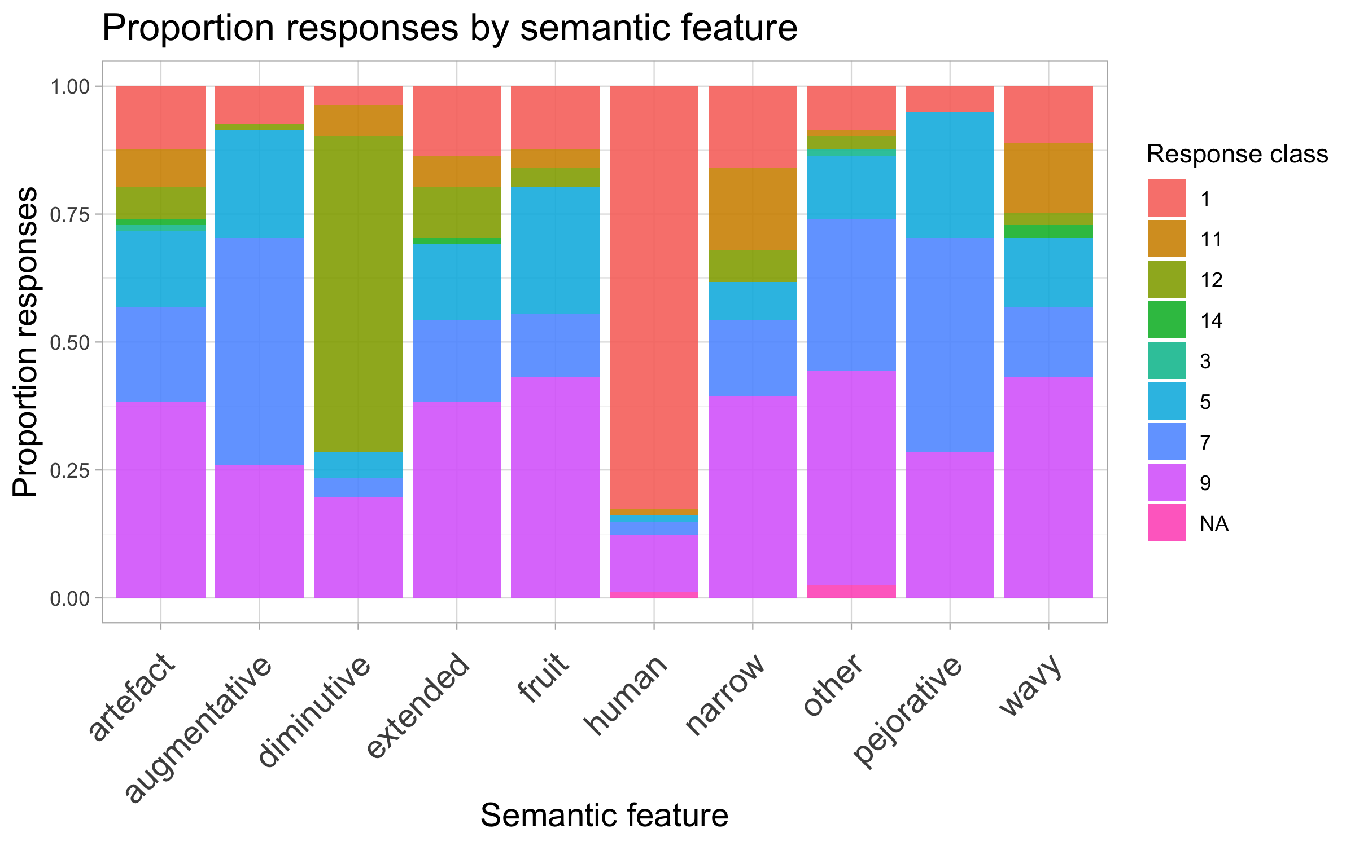
Experiment 1 results: What’s up with augmentative?

Slide 36
Experiment 1 results: What’s up with augmentative?
    A possible merger in augmentative and pejorative encoding?
    Evidence from speaker’s lexicon show the morphemes associated with augmentation and pejoration may be used interchangeably:
      Îrori/ kîrori “a lorry”
      Îrinya/kîrinya “a big hole/ditch”
      Îthoka/kîthoka “ an axe”
      The two are also used to express disdainful tone:
        Îmuntû/kîmuntû rîrî/gîkî “this bad person’

Slide 37
Implication: a possible schema
 |  | Noun
[+Evaluative] |  |  |  | [-Evaluative]
Augmentative (î - ma)
Pejorative (k(g)î - bi) Diminutive (k(g)a-k(g)a |  |  | [+Human ] û - ba (1/2) |  | [-human] Morphophonological rules
 |  |  |  |  | û - î (3/4)
 |  |  |  |  | î - ma (5/6)
 |  |  |  |  | k(g)î-bî (7/8)
 |  |  |  |  | î - i (9/10)
 |  |  |  |  | k(g)a - tû (12/13)
 |  |  |  |  | û – bû (14)
 |  |  |  |  | k(g)û – k(g)û (15)
 |  |  |  |  | a - g(k)û (16,17)

Slide 38
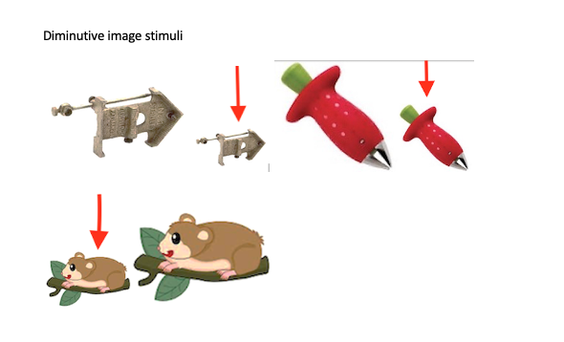
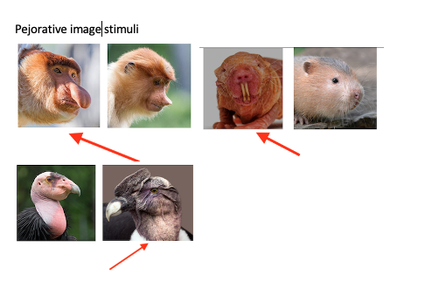
Experiment 1: image stimuli

Slide 39
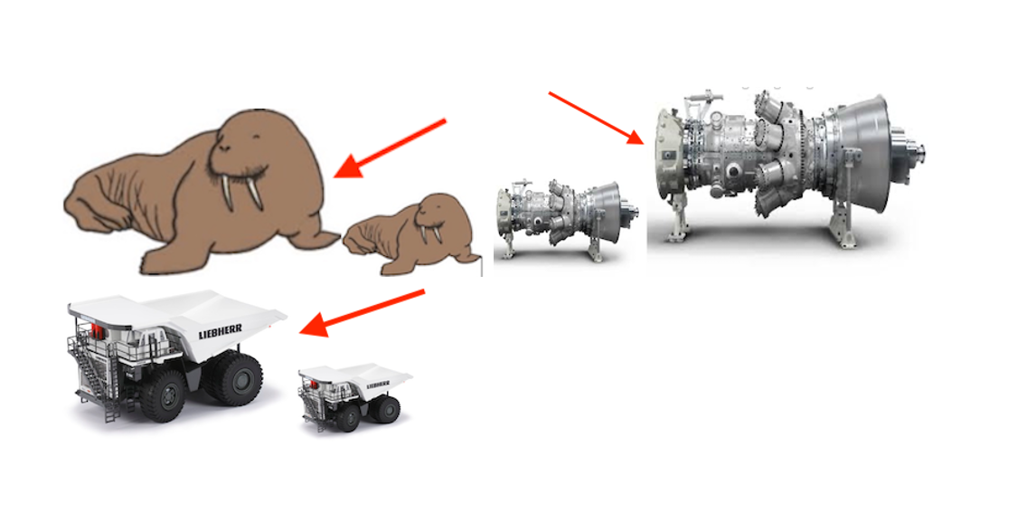
Experiment 2: Image Stimuli
Augmentative image stimuli

